Slide 1
Process Measurement

Slide 2
Process Measurement: Principles
To be useful, measurements should be
  gathered for a specific purpose
  explicitly defined
  properly managed
  properly used
Measuring your process will not improve it. You must make process changes to achieve lasting improvement.

Slide 3
Process Measurement: Purposes
We measure to
  understand and manage change
  predict or plan for the future
  compare one product, process, or organization with another
  determine adherence to standards
  provide a basis for control

Slide 4
Process Measurements: Types
We generally need objective and explicit measures
To be useful, we need relationships that correlate
  program size versus development hours
  cost distributions
  defect densities
We also seek a controlling or predictive capability
  actions to reduce test defects
  steps to improve review quality
  means to improve productivity

Slide 5
Process Measurements: in PSP
The basic PSP data are
  program size
  time spent by phase
  defects found and injected by phase
Both actual and estimated data are gathered on every item
Measures derived from these data
  support planning
  characterize process quality

Slide 6
PSP Size Measures
The goals of the PSP size measures are to
  define a consistent size measure
  establish a basis for normalizing time and defect data
  help make better size estimates
Some of the questions these data can help to answer are
  What size program did I plan to develop?
  How good was my size estimate?
  What was the completed size of the finished program?

Slide 7
PSP Time Measures
The goals of the PSP time measures are to
  determine how much time you spend in each PSP phase
  help you to make better time estimates
Typical questions these data can help answer are
  How much time did I spend by PSP phase?
  How much time did I plan to spend by PSP phase?

Slide 8
PSP Defect Measures
The goals of the PSP defect measures are to
  provide a historical baseline of defect data
  understand the numbers and types of defects injected
  understand the relative costs of removing defects in each PSP phase
Some questions these data can help answer are
  How many defects did I make in each phase?
  How many defects did I remove in each phase?
  How much time did it take to find and fix each defect?

Slide 9
Size Versus Development Effort
The principal requirement: If the size measure is not directly related to development cost, it is not worth using
There are many possible measures
  database elements
  lines of code (LOC)
  function points
  pages, screens, scripts, reports
The size measure should be sensitive to language, design, and development practice.

Slide 10
Relationship to Development
Pages are often an acceptable measure for document development
LOC is usually a good measure for developing source programs like Pascal and C++
Other possible measures are function points, screens, modules, database elements, and maintenance fixes

Slide 11
Measurement Precision
When two people measure the same thing, will they get the same result?
To do so requires a precise measurement definition
The measure must also be properly applied.
  Different people will likely have different definitions of database elements.
  Pascal LOC do not equate to assembler LOC
  New LOC are not the same as modified LOC
  Logical LOC do not equate to physical LOC
  One person’s C++ LOC may not relate to someone else’s C++ LOC

Slide 12
Machine Countable
Manual size counting is time-consuming and inaccurate
Automated counters will only work for defined product characteristics
Counters can be complex, depending on the
  size definition selected
  counting method used

Slide 13
Suitable for Early Planning -1
For making initial project plans, measures are needed that you can visualize at the beginning of the job.
  For a house, square feet predicts cost.
  Few people can visualize a house in terms of square feet of living space.
  Numbers of rooms is more intuitive.
Intuitive size measures are usually needed for initial plans

Slide 14
Suitable for Early Planning -2
Unfortunately, popular intuitive measures are not often measurable, and popular measurable measures are often not intuitive
Function points
  intuitive
  not directly measurable
LOC
  not intuitive
  directly measurable

Slide 15
LOC Measurement
The suggested PSP LOC measure uses logical (versus physical) lines of code
Statement specifications
  executable
  nonexecutable
  counted statement types
Application
  language and code type
  origin and usage

Slide 16
Counting Program Size -1
Logical lines
  invariant to editing changes
  correlate with development effort
  uniquely definable
  complex to count
Physical lines
  are easy to count
  are not invariant
  must be precisely defined for each case

Slide 17
Counting Program Size -2
The PSP uses a coding standard and a physical counter for LOC size measures
  defined coding standard
  physical line for each logical line
This standard must be faithfully followed
Then, physical line counting equals logical line counting

Slide 18
A LOC Counting Example
procedure ISet.Set(var N: int; var inc: boolean);
begin
inc := false;
SearchPtr := SetStart;
while (SearchPtr<>nil) and (inc == false) do
if SearchPtr^.ThisN == N
then
inc := true
else
SearchPtr:=SearchPtr^.NextN;
end;

Slide 19
PSP’s LOC Counting Standard
Count all statements. This includes
  begin, end, if, then, else,
  {, }, ;, .,
  declarations, directives, headers, etc.
Do not count blanks, comment lines, or automatically generated code
Count added and modified code for measuring and estimating development productivity

Slide 20
Size Accounting
For small products, size tracking can be done manually, but it requires care
For larger products, size tracking requires an accounting system
Size accounting provides an orderly and precise way of tracking size changes through multiple product versions

Slide 21
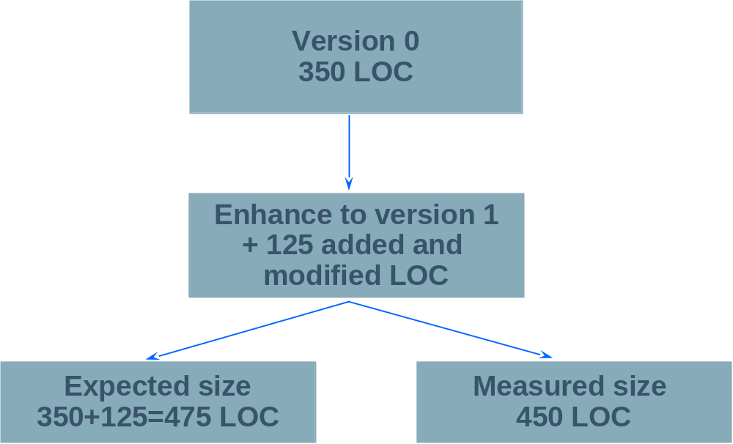
Example of Size Accounting - 1
What happened?

Slide 22
Example of Size Accounting - 2
 | Added | Subtracted | Base
Base V0 |  |  | 0
Deleted |  | 0
Modified | 0 | 0
Added | 350
Base V1 | 350 | -0 | 350
Deleted |  | 0
Modified | 25 | 25
Added | 100
V1 Product | 125 | -25 | 450
Total Added and Modified LOC |  |  | 475

Slide 23
Messages to Remember
To effectively plan and manage your work, you must measure product size
For different types of work, use different size measures
For each measure, size must correlate with development time
If the size measure does not correlate or is not automatically countable, it will not be very useful
Every size measure should be precisely defined and automatically countable.

